Slide 1
gdT Repertoire: Rarefaction and Sequence Alignment
09/04/2015

Slide 2
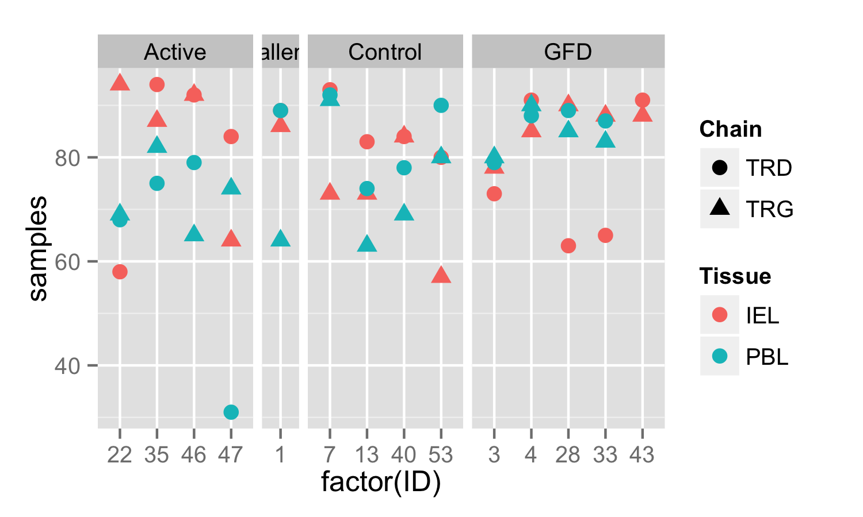
Diversity results from before did not account for differing sample sizes
I subsampled to 50 to normalize

Slide 3
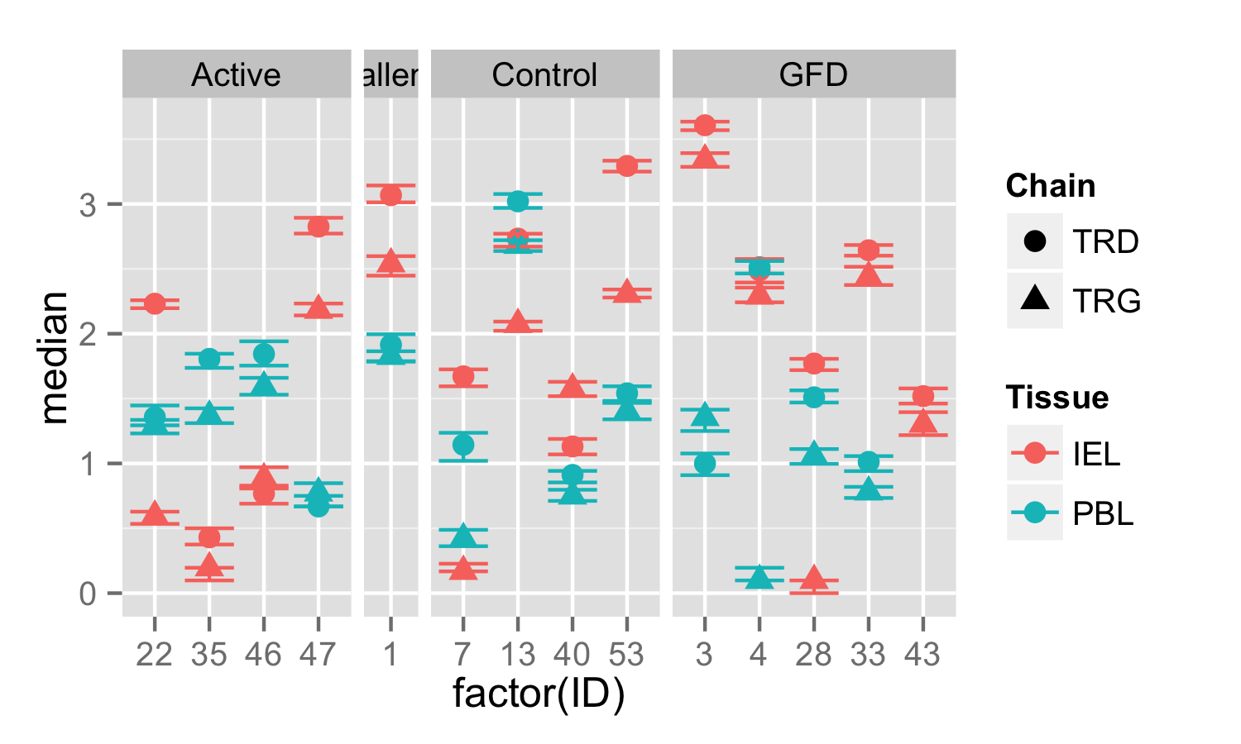
Subsampled Shannon Diversity

Slide 4
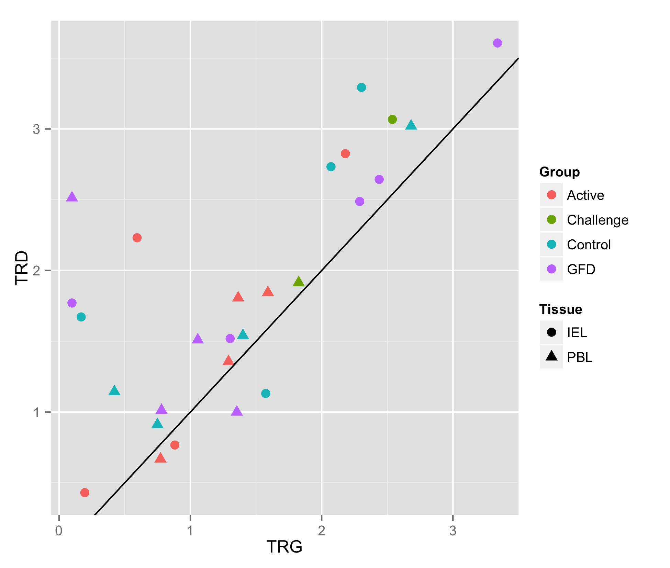
TRD Chain still tends to be more diverse per individual
Median subsampled Shannon diversity from each individual

Slide 5
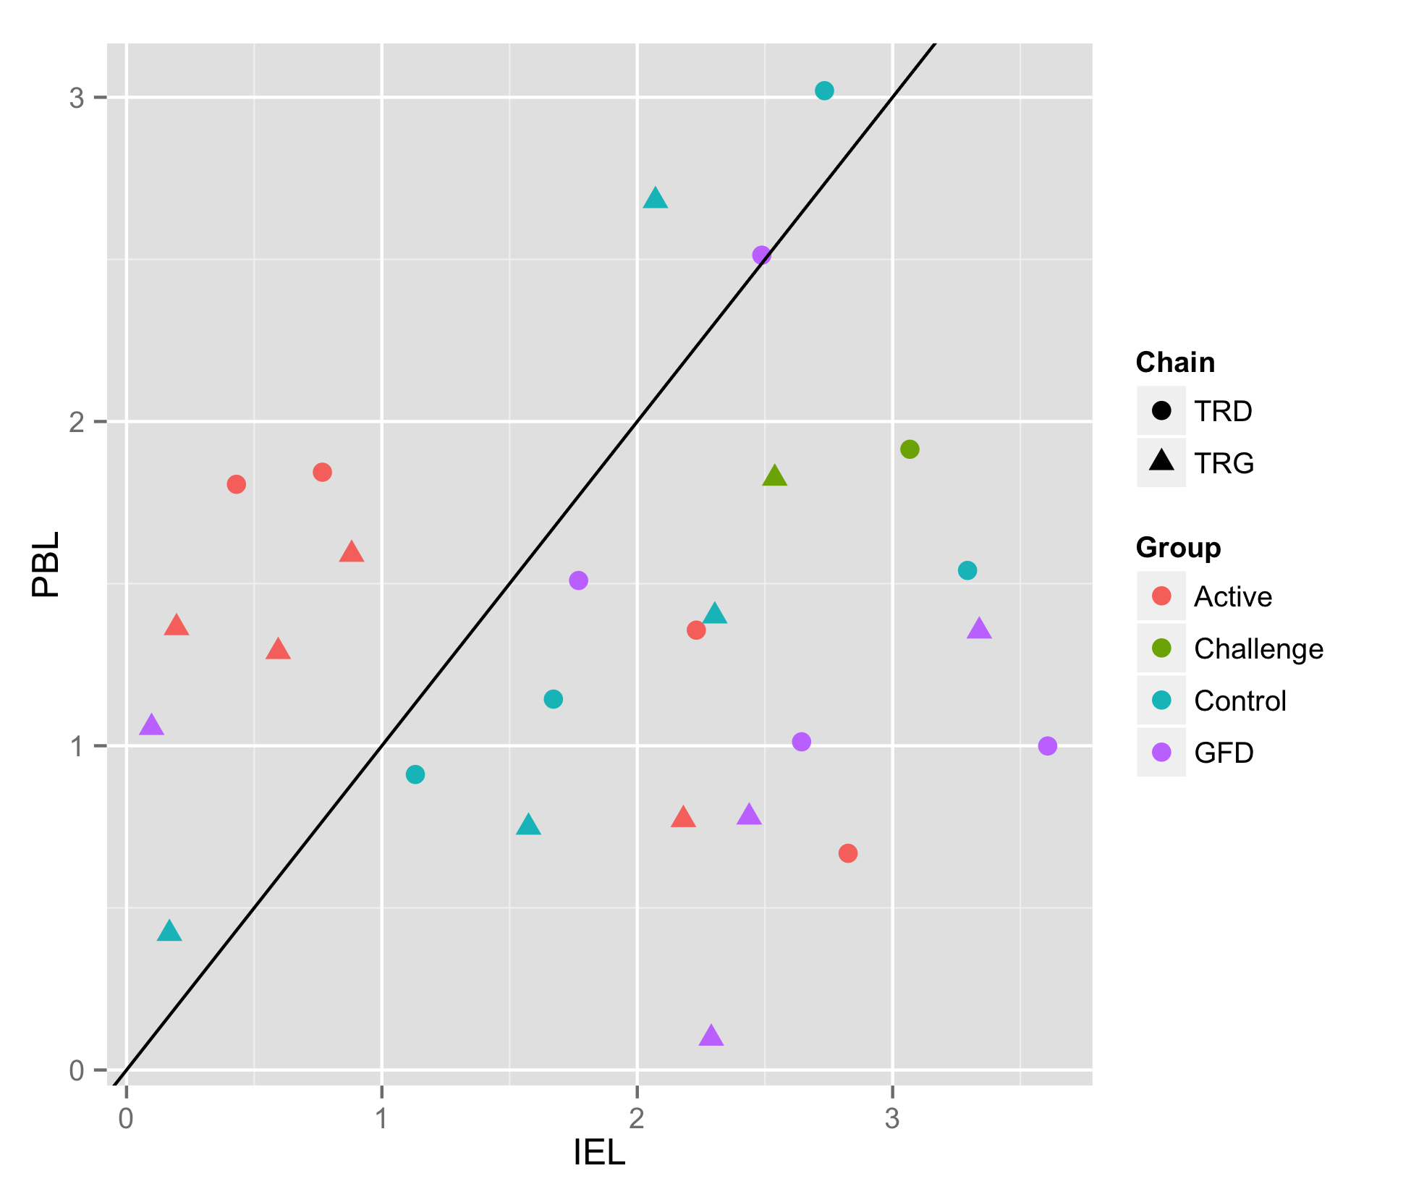
Active Group still has relatively reduced IEL Diversity
Median subsampled Shannon diversity from each individual

Slide 6
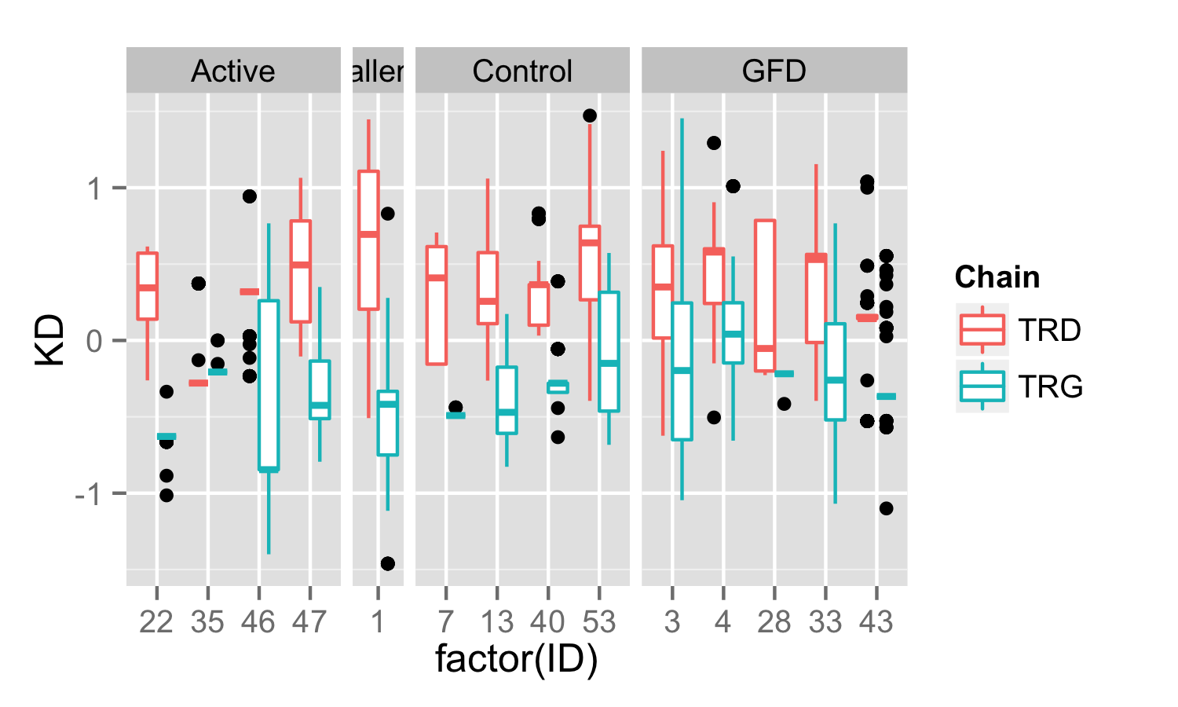
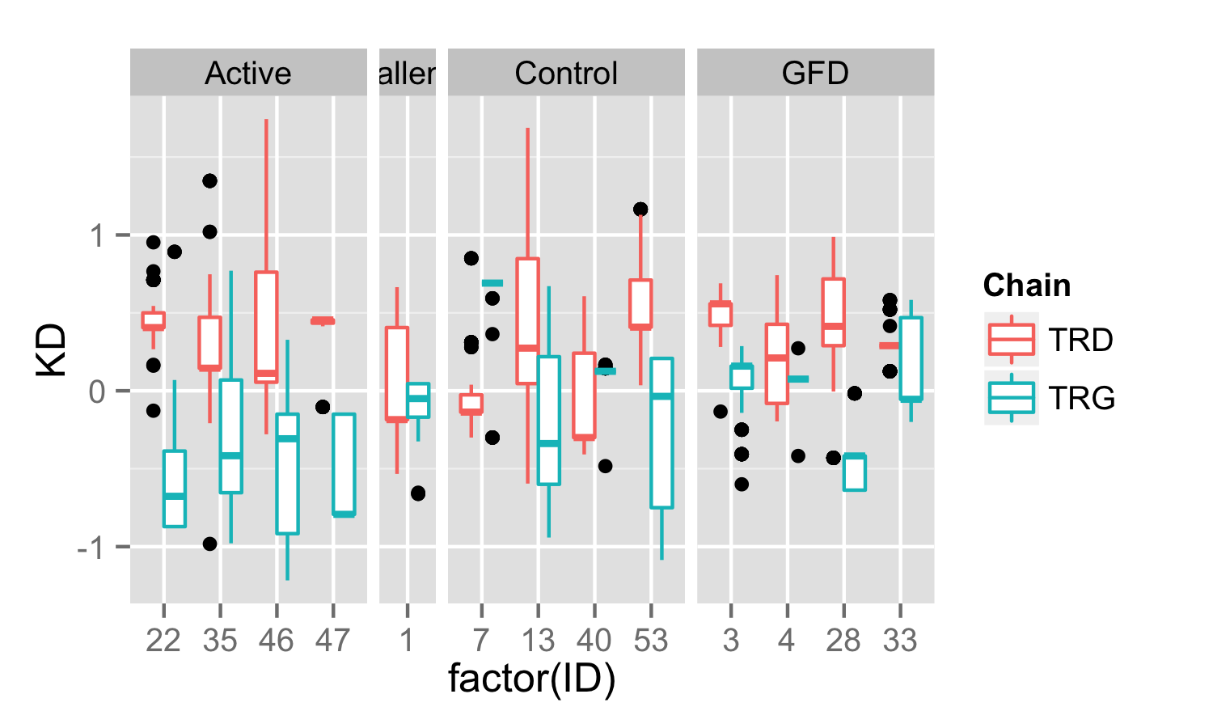
CDR3 Sequence Hydrophobicity (Kyte-Doolittle)
IEL
PBL

Slide 7
Multiple Sequence Alignment – different results from different algorithms
Muscle
TCoffee
ClustalW
Probcons
ClustalOmega
MSAprobs
GLprobs
Active TRD CDR3 Sequences

Slide 8
MSA (Muscle) of TRD CDR3 sequences by patient group
Active
Control
Challenge
GFD

Slide 9
MSA (Muscle) of TRG CDR3 sequences by patient group
Active
Control
Challenge
GFD

Slide 10
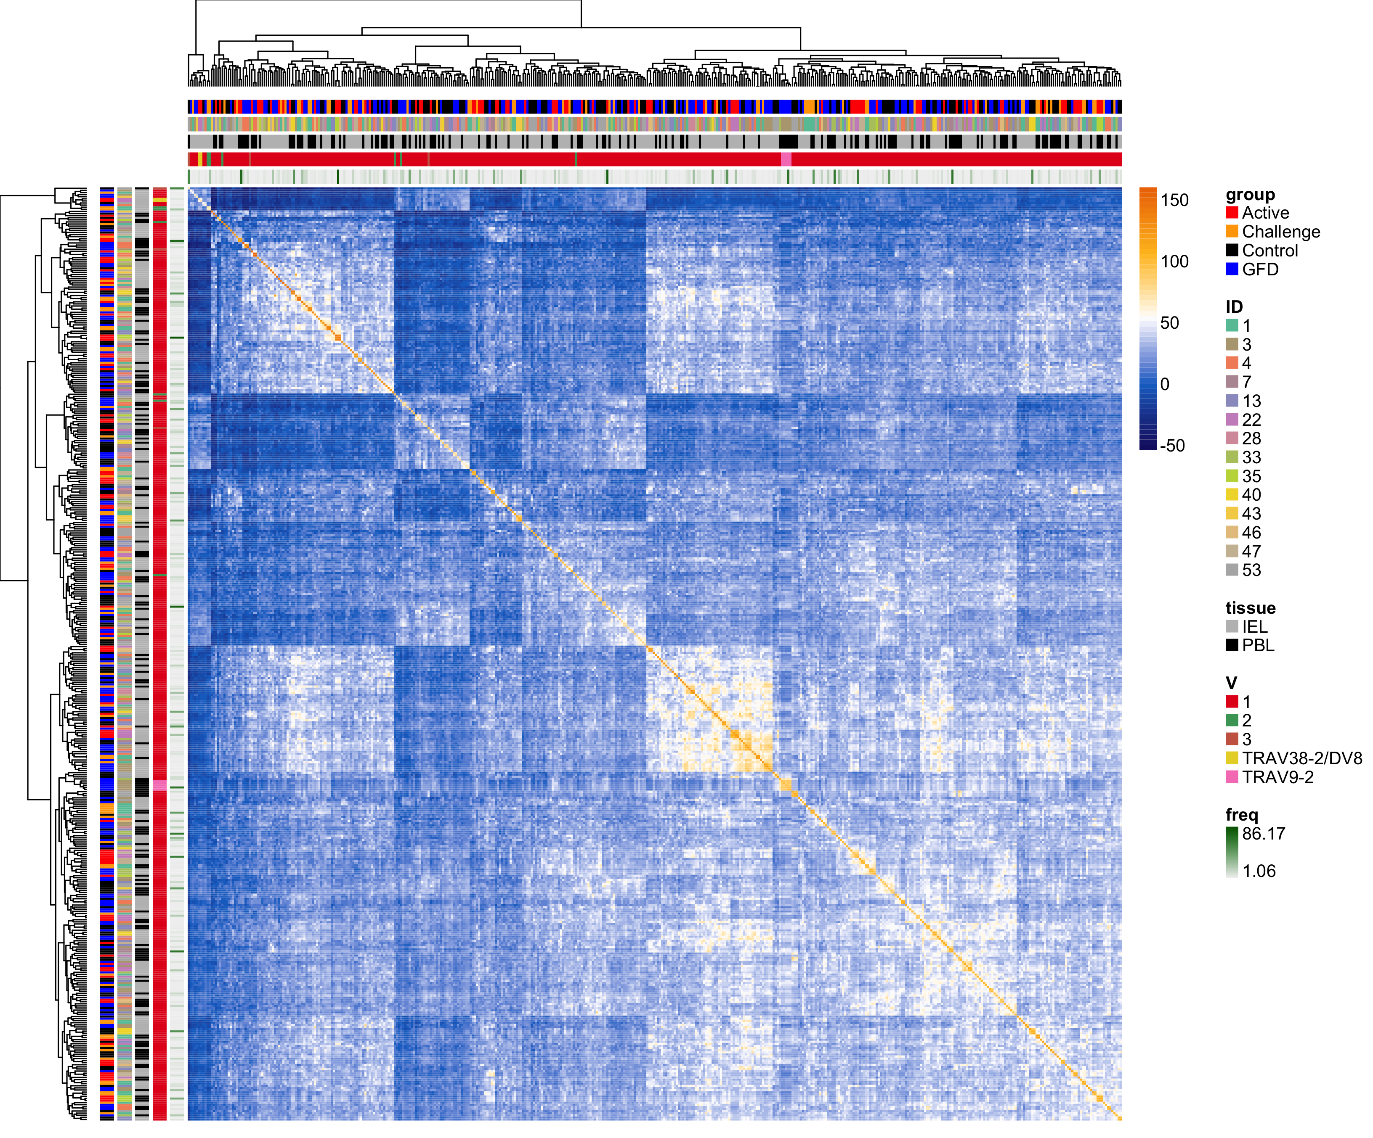
Pairwise CDR3 Sequence Similarity (BLOSUM62)
TRD

Slide 11
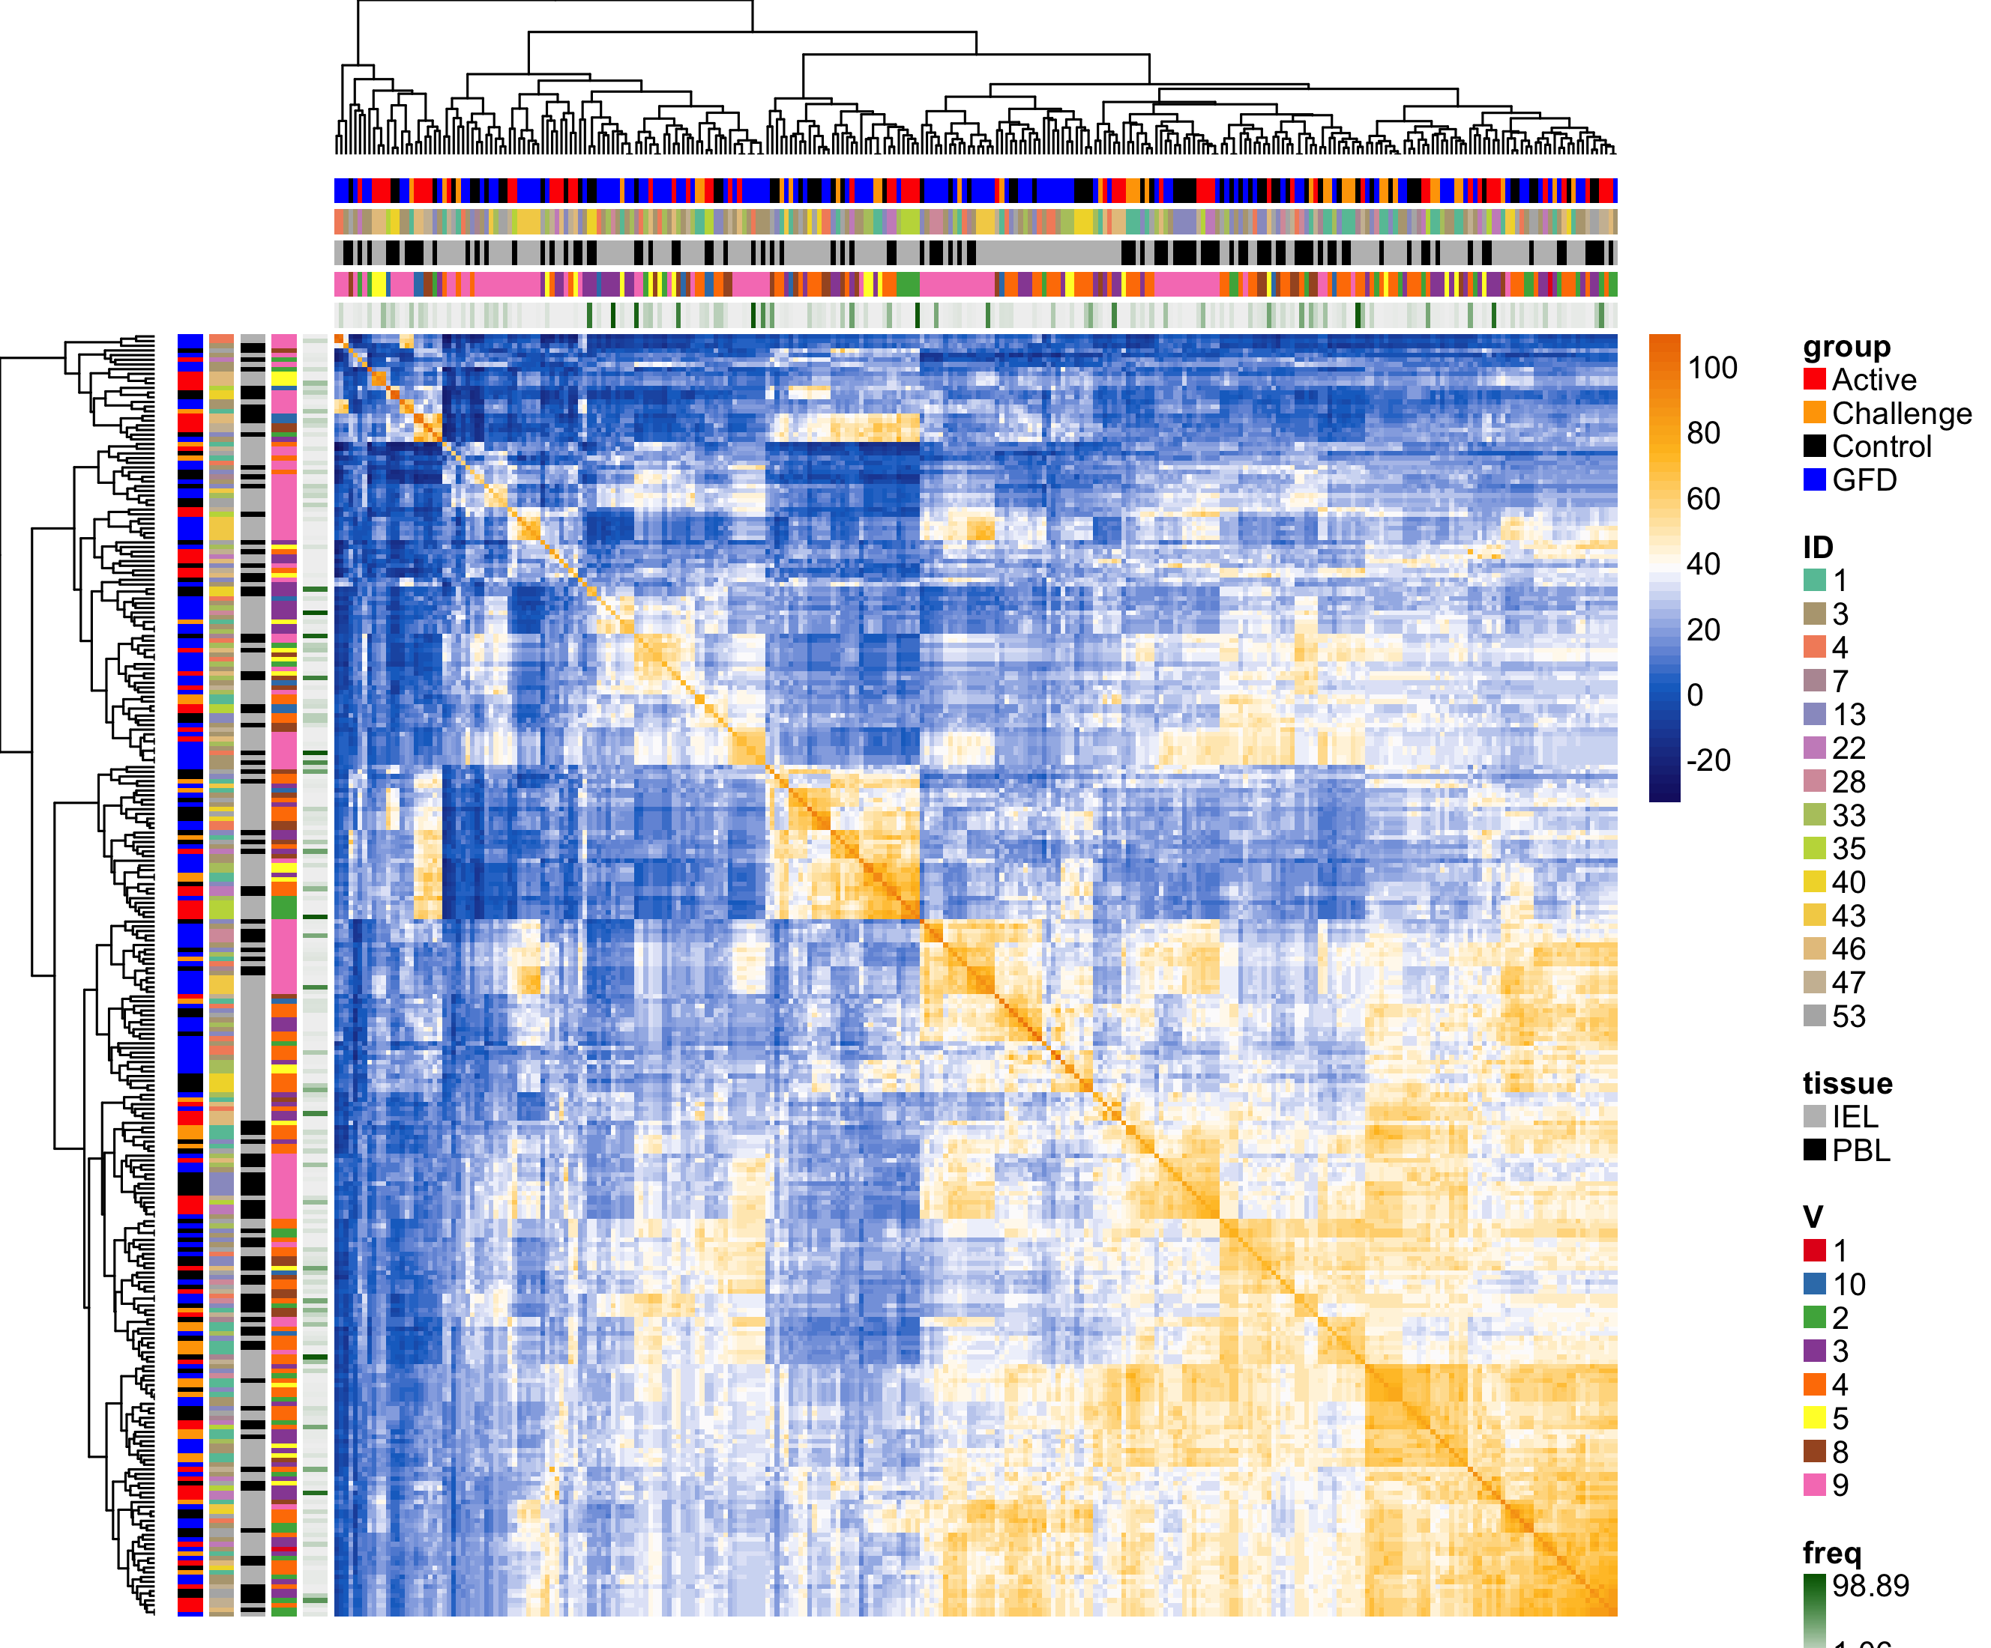
Pairwise CDR3 Sequence Similarity (BLOSUM62)
TRG

